Slide 1
LEARN SESSION
HSC UNRESTRICTED ACCOUNTING – DECEMBER 2025

Slide 2
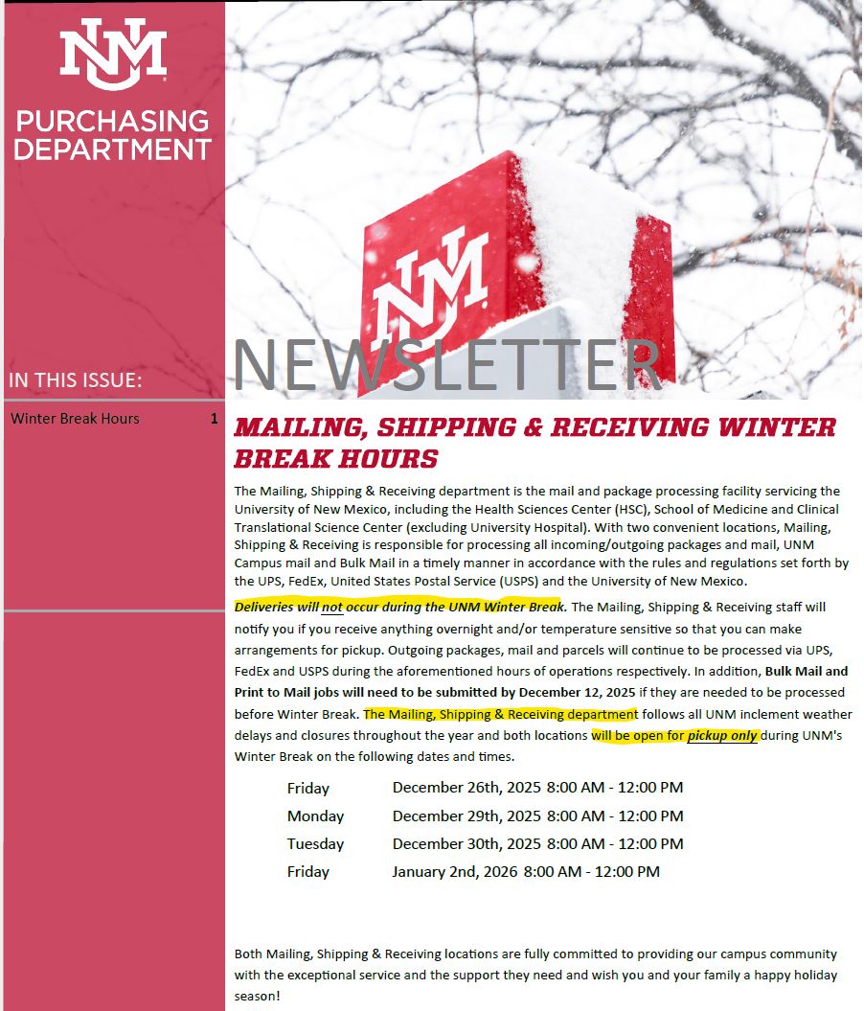
Winter Break Reminders
Place an “out of office message” on your voice mail and email to alert external customers
HSC CORE Offices will be closed 12/24/25-1/2/26
Unrestricted Accounting will clear the Requisition queue and JV queue before break.
Pcard holders - Auto-generated emails will be turned off during break; however, the clock is still running. Once the auto-generated system is turned back on, anything > 15 day will be emailed.

Slide 3
UAP 4030: Travel Expenses and Per Diem
HSC Unrestricted Accounting
August 13, 2025

Slide 4
Section 1 - General
Modified to include travelers responsibility for policy compliance
“When traveling on university business, it is the responsibility of the traveler to understand University travel policy in order to be paid or reimbursed in a timely manner and understand which expenses will and will not be covered by the University. Consequently, all UNM travelers and department personnel should:
Read and be familiar with UAP 4030 prior to travel.
Ascertain if there are any funding sources or departmental restrictions on paying for travel expenses.
Demonstrate good stewardship of University resources (i.e., spending will be reasonable and not excessive).
Obtain prior approval from an authorized supervisor or manager if the traveler has questions about planned travel (expenses not approved by an authorized supervisor or manager may not be reimbursed); and
Become familiar with the rules regarding use of a P-card for travel to ensure University funds are not used for personal travel.”

Slide 5
Section 2 – Applicability/Eligibility
New Section Name – still include accountable plan requirements
Applies to Faculty, staff, and students. Visitors subject to “reasonable” standard
Additional language for student organization travel
Added section on foreign national travel limitations
Notes:
Was titled “accountable plan”

Slide 6
Section 3 – University Paid Travel
3.1 – Eligibility definition
3.2 – Remote Work
Employees traveling between their Alternate Work Location and a UNM Worksite are not considered to be on travel status. (Hybrid)
3.3 – Documentation Required
Bullet point list of items to include
Itemized receipts for any travel-related expenses of $25 or more.
Receipt not required <$25, but details of expense must be include
3.4 – Approval of Reimbursement and Per Diem Requests
Notes:
Discuss “alternatie Work Location” concept

Slide 7
Section 4 – Prior Approval
Title change - combines inside US and International travel
Requires departments to establish procedures
REMINDER:
All international travel reports must have approval documentation attached
For HSC International Request Portal - https://app.smartsheet.com/b/publish?EQBCT=fbb0501ac45c47b592755029ed4b6179

Slide 8
Section 5 - International Travel - Export Control Compliance
https://pcard.unm.edu/policies-and-procedures/export-control.html
Contact Export Control at export@unm.edu prior to commencing travel

Slide 9
Section 6 – Health and Accident Insurance for Travel
Informational – does not imply allowable
Travel Insurance
Currently, the University does not provide blanket travel insurance coverage for faculty or staff traveling on university-related business. However, coverage may be available through the University’s existing insurance policies, which include:
Workers' Compensation Insurance – Applies in cases of work-related injuries sustained while traveling.
General Liability & Auto Liability Statutory Coverages-Applies to liabilities caused by the negligence of employees while traveling.
No action is required from faculty or staff to be eligible for these policies. However, all university-related travel must be booked in accordance with the University’s administrative policies and procedures to ensure coverage applicability and to support traveler safety. Visit the UNM Travel webpage for more information including travel booking tools and options that save time, money, and include more benefits.
Optional International Travel Insurance
For those seeking more comprehensive travel insurance, the University recognizes Cultural Insurance Services International (CISI)as a current provider. This insurance option has been effectively used by the Global Education Office for study abroad programs and may be a valuable option for travelers looking for added protection.
We encourage all employees to carefully consider their travel insurance needs before departure and to reach out to the Risk Services or Global Education Office for more specific guidance.

Slide 10
Section 7 – Transportation Expenses
No changes to this section
Transportation expenses are the ordinary and necessary expenses of getting from the traveler's place of employment to another work site while on University business. If required due to the start and end times of the business event, travel on the day before and/or after the event may be allowed. Travel time does not include time spent for personal business or time required to travel by car that exceeds travel time via commercial transportation, unless travel by car is necessitated by the nature of the trip.

Slide 11
Section 8 – Air Travel
Section 8.1 – Parking/Ride Share To/From Airport
No longer need to evaluate least expensive form
Section 8.2 – Commercial Airlines
No major modifications

Slide 12
Section 8.2.2 – Frequent Flyer Mileage
“If an employee chooses to use their own frequent flyer miles or other incentives to upgrade their travel accommodations while traveling on University business, the value of such personal property is not reimbursable by the University, as these are not actual out-of-pocket expenses that have been incurred by travelers,”

Slide 13
Section 8.2.3 – Unused Flight Credits
New section
In the event of a business trip cancellation or an employee’s resignation prior to a scheduled University business trip, unused flight credits purchased with University funds are considered University property and cannot be used for personal use. Use of such flight credits for personal use would be a violation of the New Mexico constitution Anti-Donation clause. However, an employee or departed employee may use a University flight credit for personal use if they compensate the University in full for the cost of the flight. Departments who purchase airline flights are responsible for tracking unused flight credits and ensuring that they are not used for personal use.
Previously “In Flight Technology Charges” deleted

Slide 14
Section 8 – Air Travel
8.3 - Chartered Air Transportation
8.4 - Privately Owned Aircraft

Slide 15
Section 9 – Automobile Travel
Section 9.1 – Rental
No significant changes

Slide 16
Section 9.2 – Rental Car Insurance
9.2.1. Renting Vehicles using UNM’s Negotiated Contract – removed contracted vendor names, refer to purchasing website
9.2.2. Renting Vehicles from Other Vendors
Prior approval for LDW/CDW coverage required
9.2.3. International Rental Car Insurance
No change

Slide 17
Section 9.3 – Personal Automobile
Previously GPS – deleted
9.3.1. In-State and Local Mileage
Mileage reimbursement may be allowed for in-state travel between cities and within the local area up to the IRS standard mileage rate in effect at the time of travel. When seeking reimbursement of in-state or local mileage, employees must exclude mileage normally associated with commuting from the employee’s residence to the employee’s designated UNM Worksite
9.3.2. Out-of-State Mileage
If the traveler fails to provide the required comparison information, Financial Services may deny the request for reimbursement of mileage.

Slide 18
Section 9.4 – Taxi/Ride Share/Public Transportation Fares
Must be business related.
No receipt needed if less than $25.
9.5 – Fleet Automobiles
10 – Other Types of Transportation
11 – Chartered Transportation
No changes

Slide 19
Section 12 – Paying for Travel
Recommends traveler utilize Pcard when possible.
Indicates reimbursements must be submitted within 60 days of travel, although Section 2.1 indicates 180 day limit.

Slide 20
Section 12.1 – Lodging and Meals
Traveler's may be reimbursed for their own meals, or for non-UNM employee's meals as part of a business meal. Travelers may not be reimbursed for meals for other UNM employees
Traveler's may be reimbursed for their own meals, or for non-UNM employee's meals as part of a business meal. Travelers may not be reimbursed for meals for other UNM employees
Includes exclusion of purchasing meals for other UNM employees.
Traveler's may be reimbursed for their own meals, or for non-UNM employee's meals as part of a business meal. Travelers may not be reimbursed for meals for other UNM employees

Slide 21
Section 12.2 – Method One: Day Trip Meal Allowance
Documentation must indicate 12 or more hours to be eligible for per diem allowance at 75%.
Must be reduced for meals provided.
Day Trip per diem is taxable

Slide 22
Section 12.3 – Method Two: Flat per Diem Allowance for International & Travel Within the United States
Flat rate without lodging cost
New Mexico rate set as DFA travel rate
FY26: $169 Santa Fe County
FY26: $115 All other counties
Out of state and international to use GSA approved rates.

Slide 23
Section 12.4 – Method Three: Actual Lodging Expense Reimbursed, Plus a Per Diem Meal and Incidental Expenses Reimbursement
Actual lodging cost included in reimbursement
New Mexico rate set as DFA travel rate
FY26: $70
Out of state and international to use GSA approved rates.

Slide 24
Section 12.5 – Conference Meals and Lodging
In order to determine the lodging rate for a conference and whether any meals are included in the conference fee, travelers must provide a copy of conference materials that provide this information when submitting a request for reimbursement or per diem payment. A “conference meal” is defined as a meal that is offered for separate purchase by the conference, or is included in the conference fee. When travelers incur expenses for conference meals in excess of the per diem allowances set forth above, the University will reimburse the actual meal expense upon presentation of the appropriate receipt. In that case, the request for per diem payment must also be proportionately reduced. When meals are included in conference fees, or otherwise provided, the employee’s reimbursement request must be reduced by the appropriate per diem rate for each meal provided. It is the responsibility of the traveler and/or the department to ensure that any conference or program provided meals are deducted from a reimbursement or per diem payment request, to safeguard the University from paying for meals already included in conference or program fees. In the event the conference meals provided are not suitable for the traveler due to medical, dietary or religious restrictions, the traveler need not deduct the cost of the conference meal when seeking reimbursement , when documentation of the restriction is included in the business purpose.
Continental breakfast provided at a hotel, or by a conference, does not require a reduction in per diem when conference or hotel materials clearly indicate a “continental” breakfast is provided.
Conference lodging costs which exceed the cost of lodging advertised in the conference materials must be explained when seeking reimbursement.
Notes:
Conference agenda instead of the link – For historical retention purposes
Conference brochure – to header and not daily line item

Slide 25
Section 12.6 – Field Travel
Pursuant to federal travel regulations governing field research travel, travelers on field travel status, defined as travel for an extended period where normal accommodations either are not available or desirable, will be reimbursed at an amount up to 60% of the GSA rate in effect at the time of travel
Notes:
Was flat rate of $75

Slide 26
Section 13 – Combining Business Travel with Personal Travel
University business travelers may combine business travel with personal travel, as long as doing so does not change the primary purpose of the travel from business to personal. If the primary purpose is determined to be personal, under IRS guidelines, certain costs may not be reimbursable.
A University PCard must not be used for personal travel costs when a trip combines business and personal travel.
Notes:
Reminder – Conferences, what was personal. Details, details, details.

Slide 27
Section 13.1 – 13.4
13.1. Airfare
13.2. Ground Transportation
13.3. Lodging Costs
13.4. Meal Per Diem
Unchanged

Slide 28
Section 13.5 – Lodging with Family or Friends
Travelers may, and are encouraged to, take advantage of staying with friends or family who live at the travelers' business destinations, in order to save UNM the cost of lodging. Though such travelers have no lodging costs, they are entitled to be reimbursed up to the applicable per diem rate, as described in Section 12.2 of this policy.
Notes:
Was flat rate used for field travel

Slide 29
Section 14 – 18 - unchanged
14. Miscellaneous Expenses
15. Passports
16. International Exchange Rates
17. Exceptions

Slide 30
Policy Refreshers – Common Violations
Please educate faculty and staff on the following:
Policy 4030, section 12.1 – (Business meetings on UNM Travel) “Travelers may be reimbursed for their own meals, or for non-UNM employees' meals as part of a business meal. Travelers may not be reimbursed for meals for other UNM employees.”
Policy 4320, section 5 – (Request for Reimbursement for Services - Not Allowed) “Items not authorized for reimbursement include salary payments, payments for outside services, and any unallowable expenditure.”

Slide 31

Please email with any topics you would like discussed at future LEARN Sessions
JLChavez@salud.unm.edu

